Slide 1

Knowledge Base Question Answering via Encoding of Complex Query Structures
Kangqi Luo, Fengli Lin, Xusheng Luo, Kenny Q. Zhu
Shanghai Jiao Tong University
Sept 12nd, 2018
Notes:
Hello everyone, my name is Kangqi Luo from Shanghai Jiao Tong University. This time I will present my paper entitled “…”.
This is a joint work with former Fengli, Xusheng, and my advisor Prof. Kenny Zhu.
(Next: KB)

Slide 2




Background: Knowledge Bases
m.09c7w0
United States
containedBy
m.02nw821
Jim Lovell
m.030qb3t
Los Angeles
character
film.actor
Actor
placeOfBirth
m.011yd2
Apollo 13
m.0jtp74
IsA
film
m.0bxtg
Tom Hanks
starring
subTypeOf
IsA
people.person
Person
parents
dateOfBirth
1956-07-09
gender
m. 0c0m2j7
Chet Hanks
m.05zppz
Male
gender
Figure 1: A fragment of Freebase

Slide 3
Background: KBQA
Input: Natural language questions
Factoid questions
Describe existing facts of specific entities
Output: Entities (or literal values) in KB
Example: “What’s the capital of United States ?”
Answer: Washington, D.C. (m.0rh6k)
Notes:
KBQA: answering factoid questions

Slide 4

Simple vs Complex Questions
“What’s the capital of United States ?”
(united_states, capital, ?)
Simple question
entity linking
predicate mapping
PREFIX fb: <http://rdf.freebase.com/ns/>
SELECT ?obj ?name WHERE {
fb:m.09c7w0 fb:location.country.capital ?obj .
?obj fb:type.object.name ?name .
}
Querying over KB
Notes:
This is a simple question
one solution: entity linking + predicate matching
Making it a simple fact query in Freebase

Slide 5
Simple vs Complex Questions
“What is the second longest river in United States ?”
(united_states, second_longest_river, ?)
Predicate not in Freebase
“Who is the youngest US president after 2002 ?”
Involving multiple constraints
Complex questions
Can’t convert to a simple (entity, predicate, ?) query
Notes:
introduce entity, type, time, ordinal

Slide 6
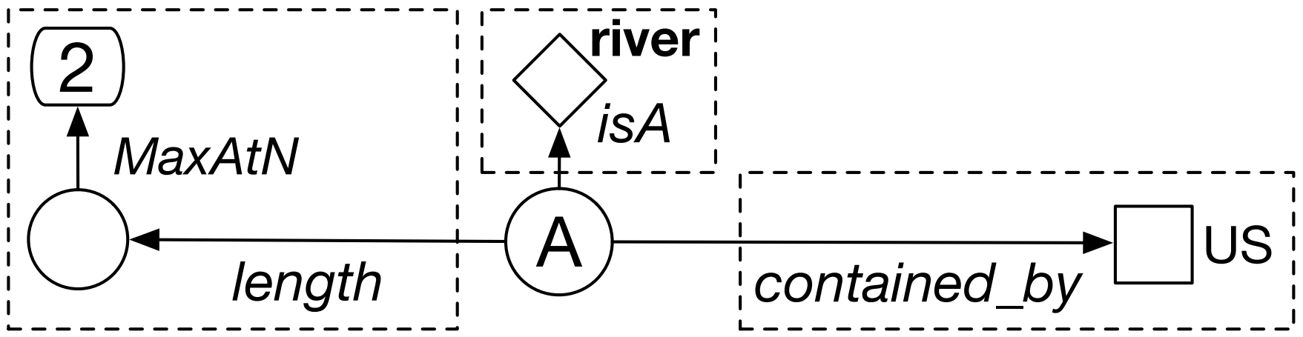
Query Graph of Questions
“What is the second longest river in United States ?”
Component 1: the answer is contained by US;
Component 2: the answer is a river;
Component 3: the answer ranks 2nd by length DESC.
Figure 2: Example of a complex query graph.
Notes:
clue = constraint = component

Slide 7
Approach Overview: Semantic Parsing
Candidate structure generation
Staged query graph generation
Handling multiple constraints: entity, type, time, ordinal
Query graph re-rank
NN-based semantic matching model
Calculate similarity between the question and the query graph

Slide 8
Approach Overview: Semantic Parsing
Candidate structure generation
Staged query graph generation
Handling multiple constraints: entity, type, time, ordinal
Query graph re-rank
NN-based semantic matching model
Calculate similarity between the question and the query graph

Slide 9
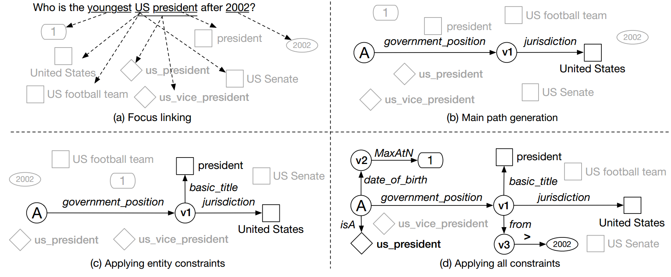
Candidate Structure Generation
“Staged Query Graph Generation”

Slide 10
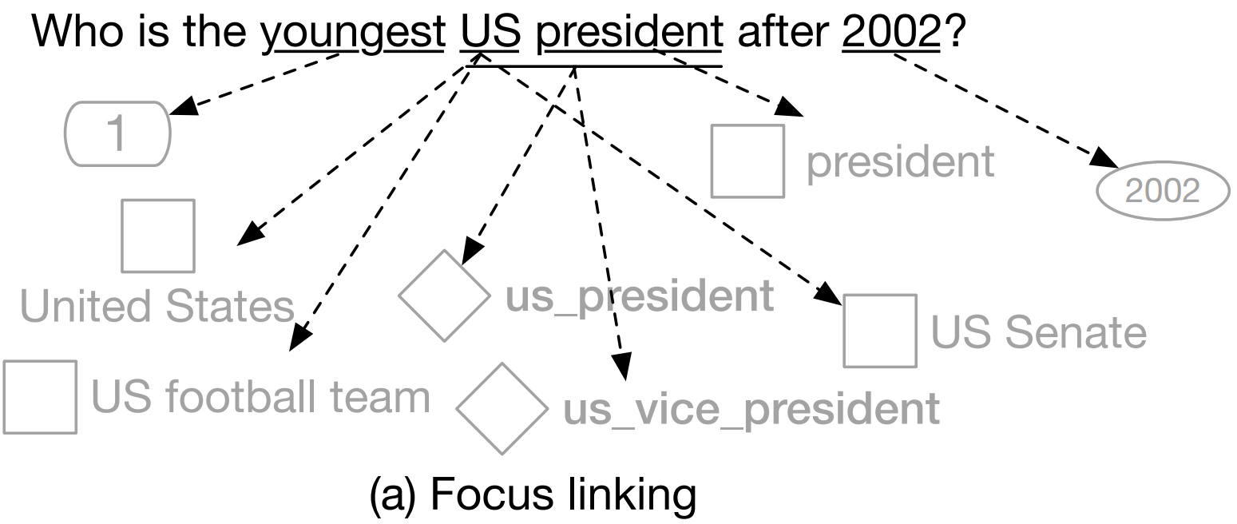
Candidate Structure Generation
Step 1: Focus linking
Entity: S-MART linker
Type: embedding
Time: direct match
Ordinal: superlative list
Notes:
introduce S-MART

Slide 11
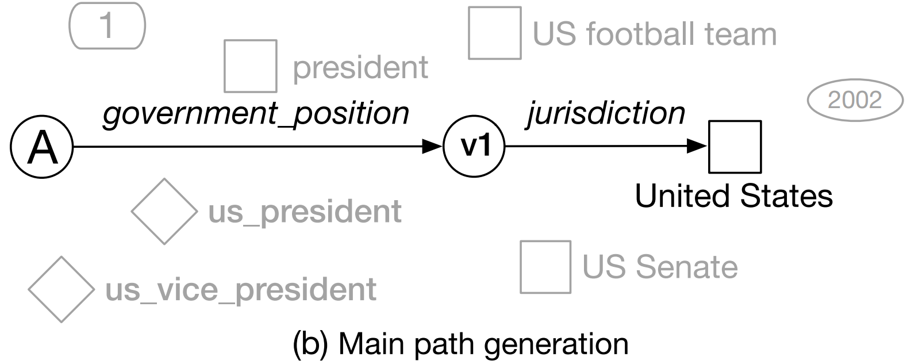
Candidate Structure Generation
Step 2: Main path generation
Link the answer with one focus entity
via 1-hop predicate (or 2-hop sequence)
Notes:
multiple paths

Slide 12
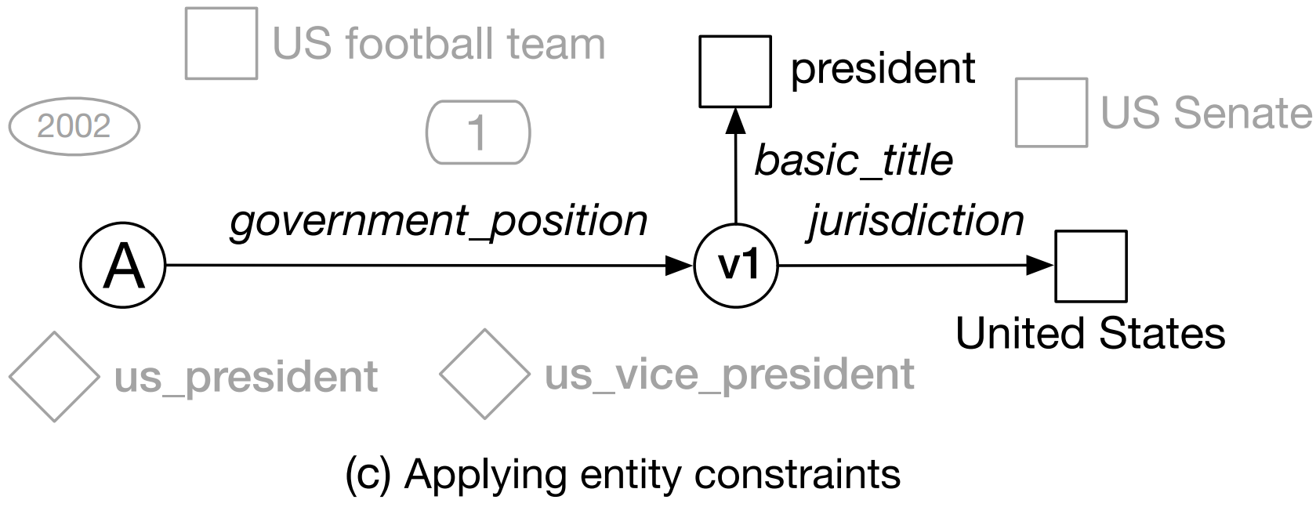
Candidate Structure Generation
Step 3: Attaching entity constraints
Depth-first search
linking other entities to the path via 1-hop predicate
Notes:
multiple structures

Slide 13
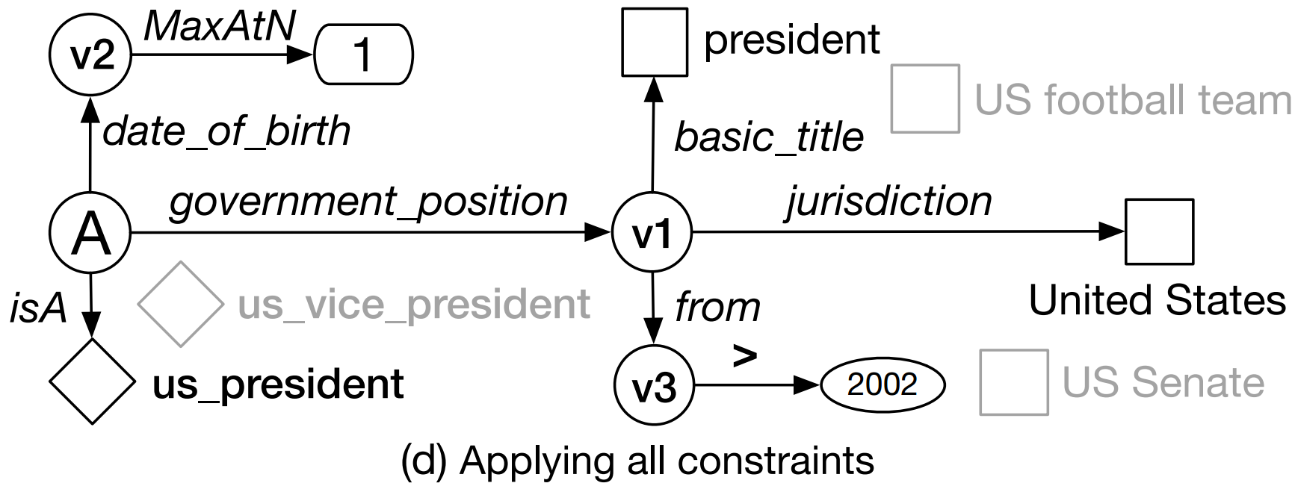
Candidate Structure Generation
Step 4&5: Type, time & ordinal constraint generation
Type filtering based on implicit types
Determine time comparing operation from sentence
Notes:
multiple structures, not only one

Slide 14
Candidate Structure Generation
SPARQL query example
202.120.38.146:8999/sparql
PREFIX fb: <http://rdf.freebase.com/ns/>
SELECT ?obj ?name WHERE {
?obj fb:government.politician.government_positions_held ?v1 .
?v1 fb:government.government_position_held.jurisdiction_of_office fb:m.09c7w0 .
?v1 fb:government.government_position_held.basic_title fb:m.060c4 .
?v1 fb:government.government_position_held.from ?v3 .
?obj fb:type.object.type fb:government.us_president .
?obj fb:people.person.date_of_birth ?v2 .
?obj fb:type.object.name ?name .
FILTER (xsd:dateTime(?v3) >= "2002-01-01"^^xsd:dateTime) .
} ORDER BY DESC(?v2) LIMIT 1

Slide 15
Approach Overview: Semantic Parsing
Candidate structure generation
Staged query graph generation
Handling multiple constraints: entity, type, time, ordinal
Query graph re-rank
NN-based semantic matching model
Calculate similarity between the question and the query graph

Slide 16
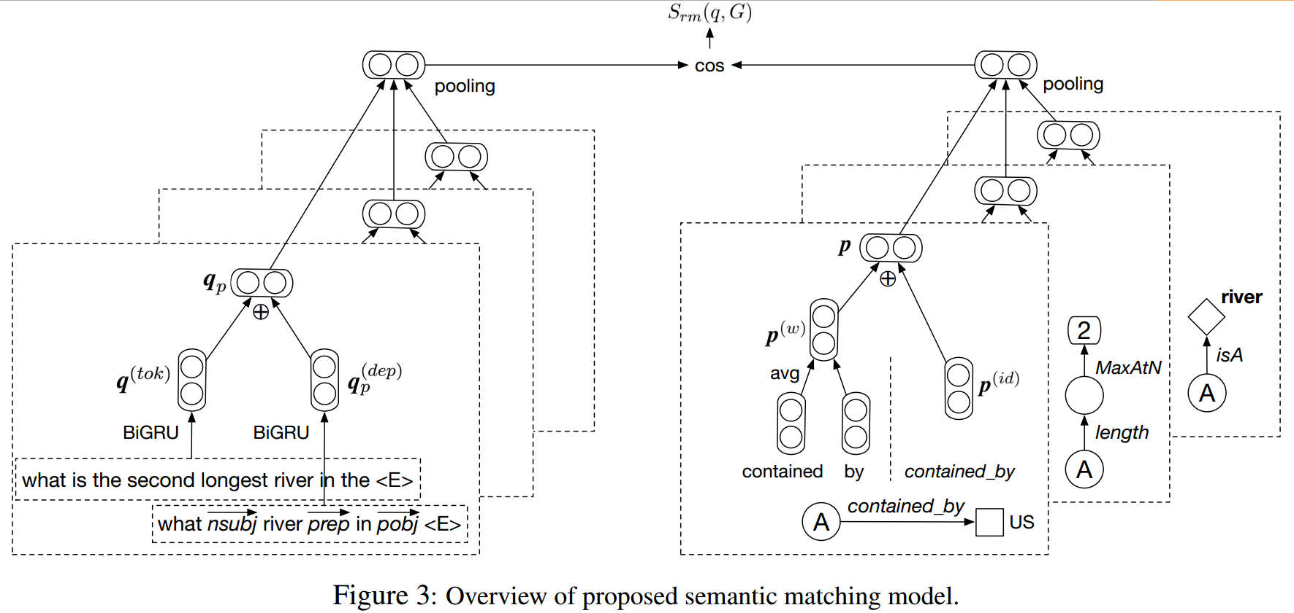
Semantic Matching Model
Notes:
We apply max pooling over the hidden vectors of semantic components, and get the compositional semantic representation of the entire query graph

Slide 17
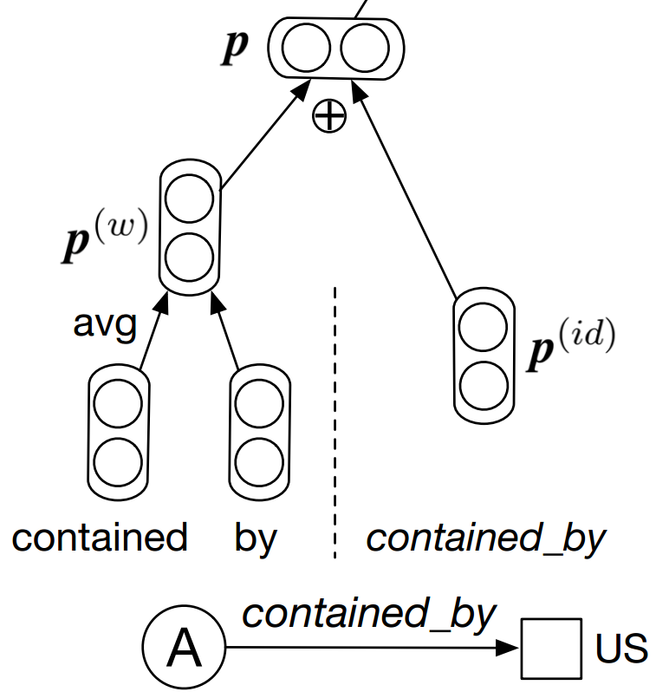
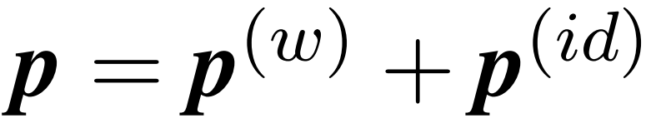
Semantic Component Representation
Predicate sequence: id & names
id seq.: { contained_by }
path level embedding
name seq.: { “contained”, “by” }
word average embedding
entire representation: summation
Notes:
small figure here

Slide 18
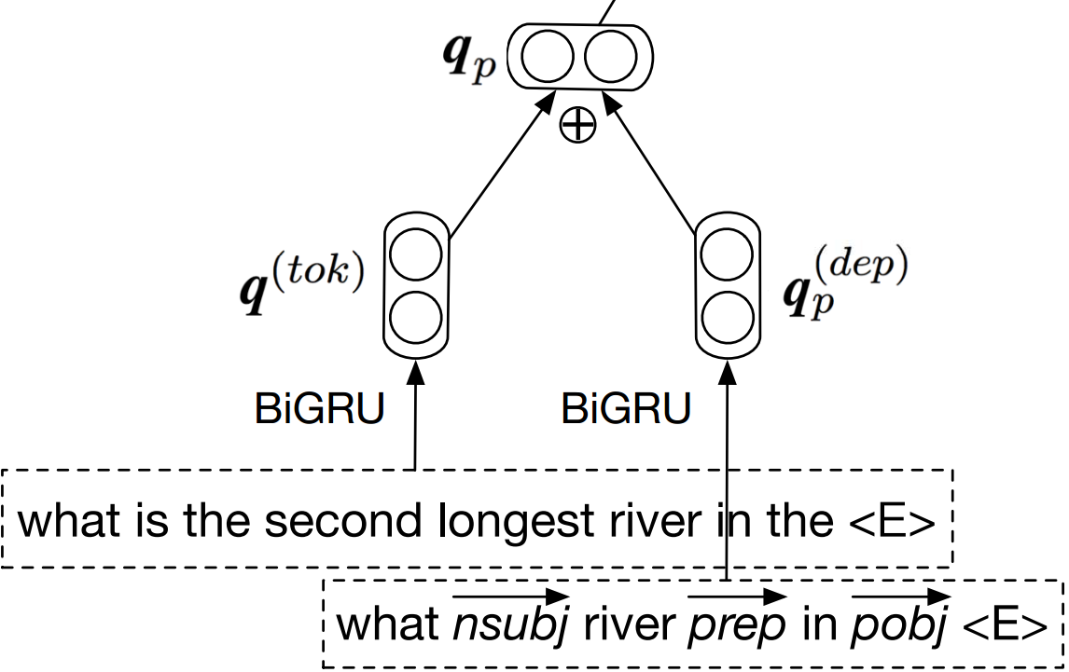

Question Representation
Sentential + Dependency Information
raw word sequence
shortest path along dependency tree
GRU as recurrent encoder
$$q_{p}=q^{(tok)}+q_{p}^{(dep)}$$
Notes:
draw on white board is ok

Slide 19
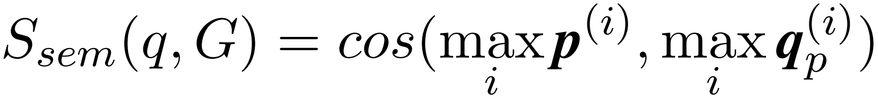
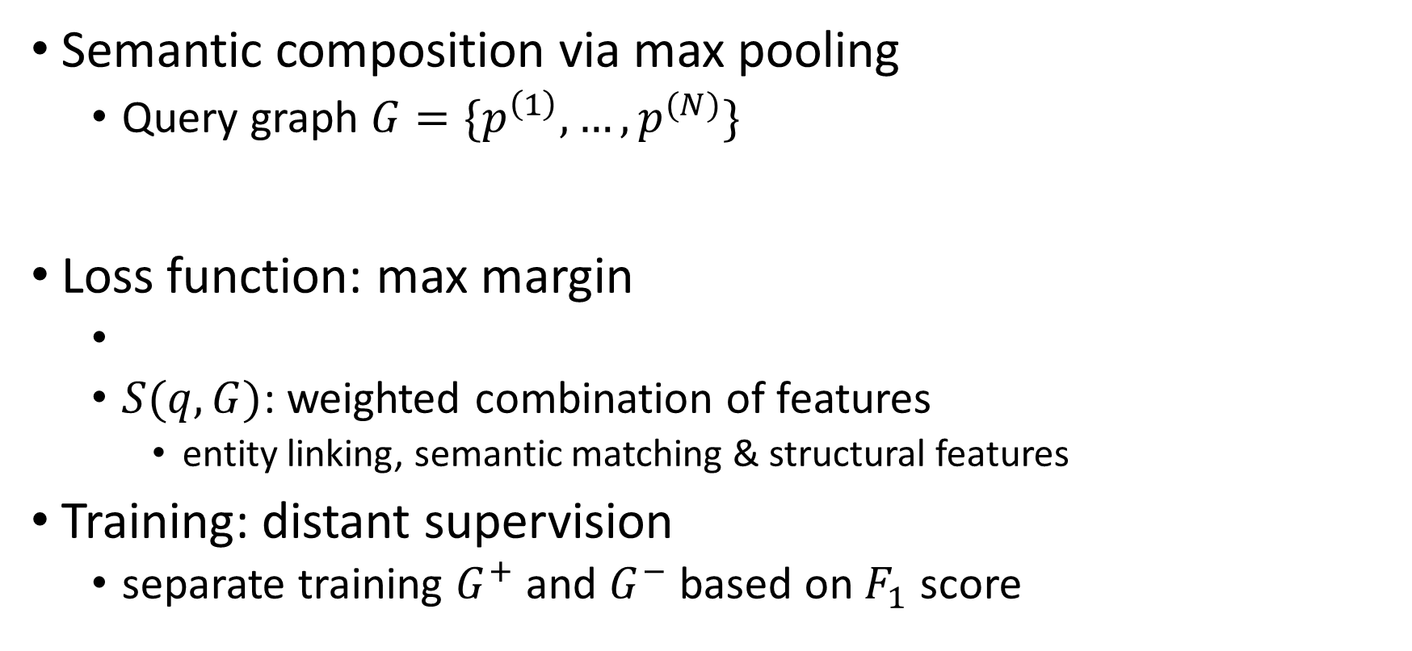
Objective & Loss Function
Semantic composition via max pooling
Query graph $G=\{p^{\left(1\right)},…,p^{(N)}\}$
Loss function: max margin
$S(q,G)$: weighted combination of features
entity linking, semantic matching & structural features
Training: distant supervision
separate training $G^{+}$ and $G^{−}$ based on $F_{1}$ score

Slide 20

Entity Linking Enrichment
Generate pseudo S-MART by learning
Extracting from
article title, redirect,
anchor text, disamb page
2-layer regression
S-MART
(mention, entity, score)
Wiki Lexicon
(mention, entity)
Training
Features
Fitting
linking probability,
letter-tri-gram Jaccard,
popularity …
Top-K Filtering
Pseudo S-MART
(mention, entity, score)
Notes:
generate pseudo S-MART result from Wikipedia

Slide 21
Experimental Setup
Knowledge Base: Freebase dump (full)
> 46M entities and billions of facts
QA dataset
ComplexQuestions (Bao et al., 2016)
2100 complex questions
WebQuestions (Berant et al., 2013)
5810 questions (~15% complex)
SimpleQuestions (Bordes et al., 2015)
>100K simple questions
Evaluated on FB2M

Slide 22
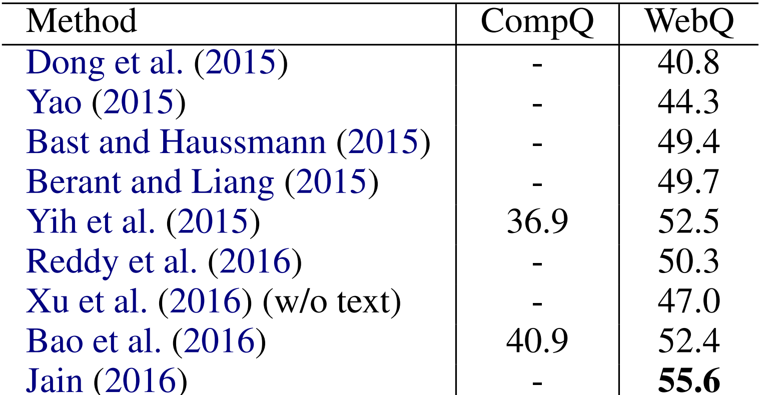
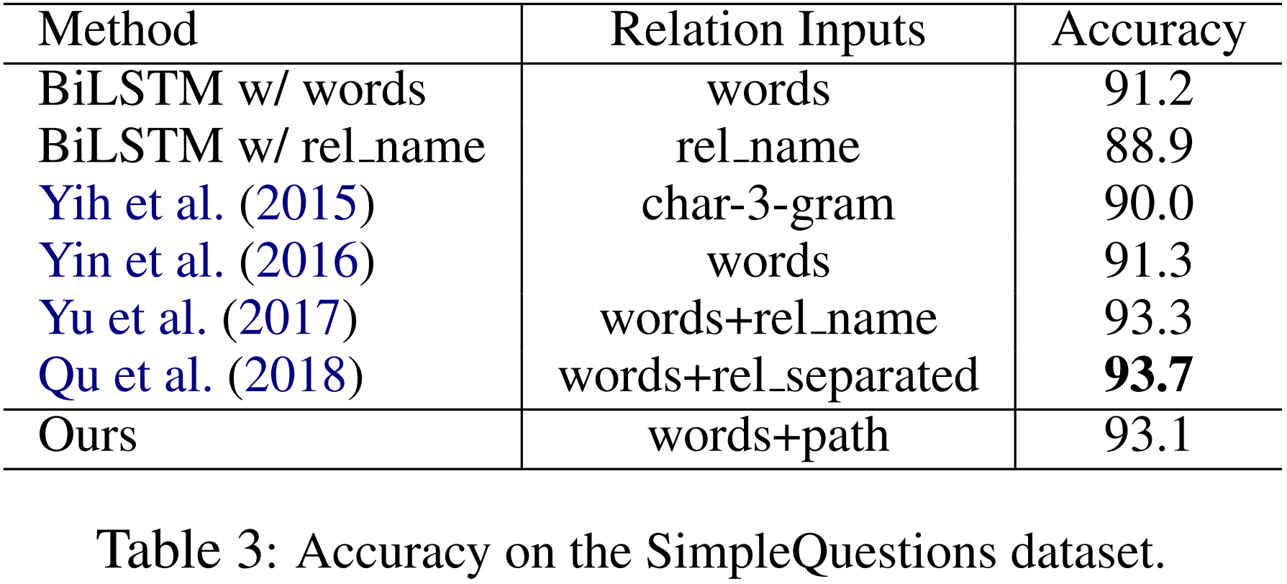
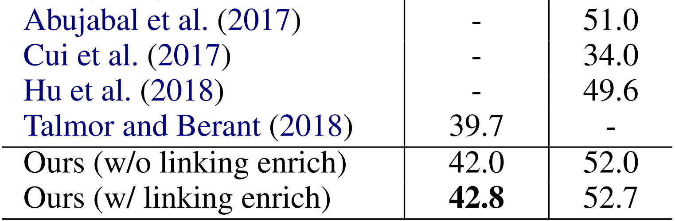
End-to-End Evaluation on WebQ & CompQ
Notes:
new state-of-the-art in CompQ
competitive in WebQ, better than using ClueWeb12 as training data

Slide 23
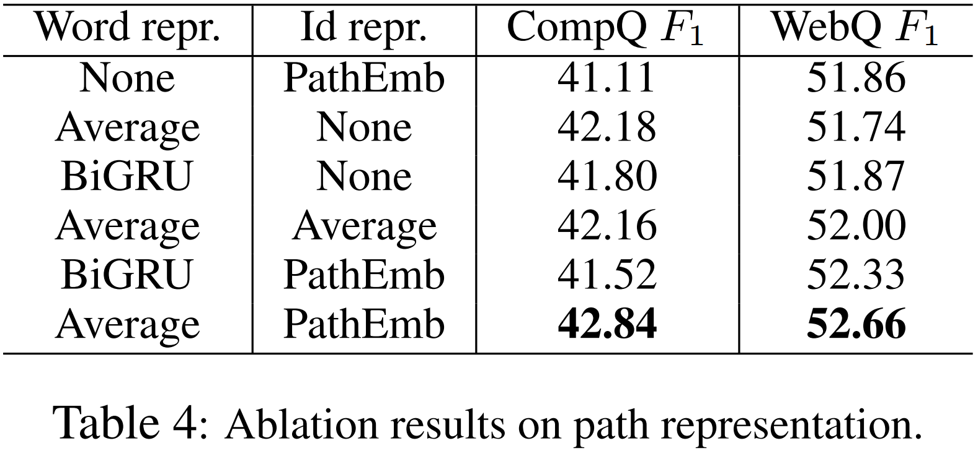

Ablation: Semantic Component Repr.
None: either $p^{(w)}$ or $p^{(id)}$ is not employed.
Notes:
None:
ignoring either word or id sequence, perform worse than the bottom three settings. gap not large: mainly because predicate id features are largely covered by their word name features.
PathEmb better than average
The former method treats the whole sequence as a single unit, which is more flexible and can potentially learn diverse representations of id sequences that share the same predicates.

Slide 24
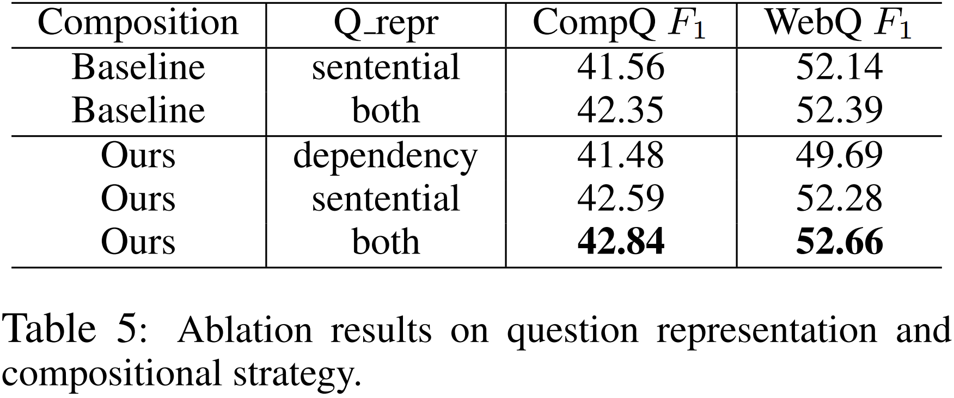
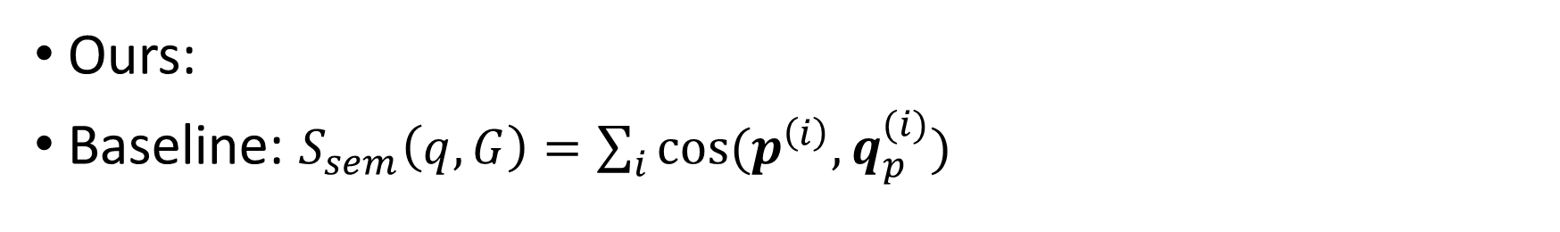
Ablation: Semantic Composition
Ours:
Baseline: $S_{sem}\left(q,G\right)=\sum_{i}{cos⁡(p^{\left(i\right)},q_{p}^{(i)})}$
Notes:
Ours: consistently outperforms baseline approach
demonstrating the effectiveness of semantic composition
Dependency is a good complementary to sentential only encoding
because dependency paths focus on hidden features at syntactic and functional perspective

Slide 25
Conclusion
Handle KBQA task in the scenario of complex semantics
Explicitly encoding the complete semantics of the query graph using neural networks
Leveraging dependency parse and linking enrichment to further improve the overall performance
Competitive in both complex & simple QA datasets
Notes:
As a conclusion,
…
The main contribution is to.

Slide 26
Thanks for listening!
Questions & Answers
Notes:
Hope you enjoy my talk, and thank you so much for your time!!

